Slide 1

USED CAR: PRICE PREDICTION
The client works with small traders, who sell used cars. Hence, by using the websites such as olx, & cardekho, we need to scrap the data & using this data, we need to build the machine learning model, which would help the client to understand the used car market & accordingly they would be able to sell the used car in the market
FLIP ROBO REMOTE INTERNSHIP
Developed By:
Deepam Purkayastha

Slide 2
Problem Statement:
With the COVID-19 impact in the market, we have seen lot of changes in the car market. Now some cars are in demand hence making them costly and some are not in demand hence cheaper. One of our clients works with small traders, who sell used cars. With the change in market due to COVID-19 impact, our client is facing problems with their previous car price valuation machine learning models. So, they are looking for new machine learning models from new data. We have to make car price valuation model.
Objective:
The client works with small traders, who sell used cars. Hence, by using the websites such as olx, & cardekho, we need to scrap the data & using this data, we need to build the machine learning model, which would help the client to understand the used car market & accordingly they would be able to sell the used car in the market.

Slide 3
Data analysis to model building flowchart
Import Libraries
Dataset Collection
Data preprocessing
Encoding(if required)
EDA
Checking Null Values
Checked for co-relation
Checked for Outliers/Skewness
Proceed for Model building(Train/Test)
Saving the Model
Hyper Parameter Tuning
R2 Score, Cross Validation, MSE, RMSE, MAE

Slide 4
Data Pre-processing Done
Importing Libraries.
Read the CSV file and convert into data frame.
Checking the data dimensions for the original dataset.
Looking for null values if any, in heat map. & accordingly fill the NaNs.
Checking the summary of the dataset.
Checking unique values.
Checking all the categorical columns in the dataset.
Visualizing each features using matplotlib and Seaborn.
Performed encoding if required.
Checked for co-relation/multi-collinearity.
Checked for Outliers/Skewness & act accordingly.
Perform Scaling using minmax Scaler method.
Checked for the final dimension of dataset: 938 rows & 45 columns.
Created train test split: We have split the train & test data in 0.2 test size with finding the best random state, which is 46.

Slide 5
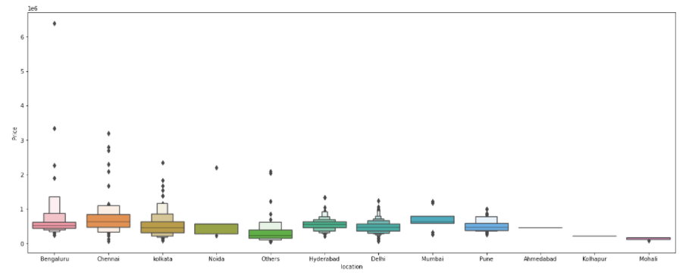
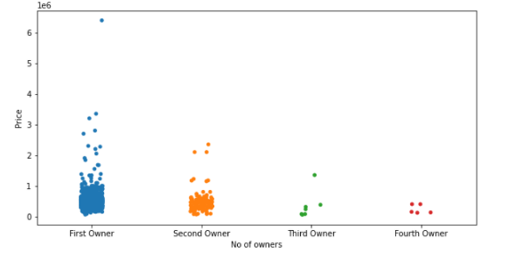
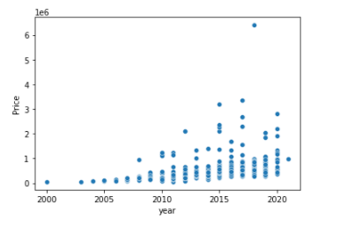
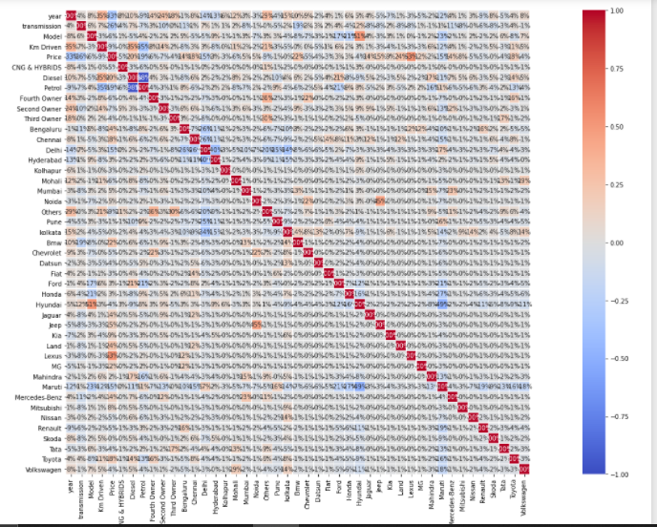
Exploratory Data Analysis through Visualizations
I have all the data format as Integer & float in the dataset. To visualize the inputs-output relationship, I have used Boxen plot, Strip plot, heat map & Scatter plot , which helped me to understand that each categorical feature has some relation with the price. Hence kept all the features for model building.
Most of the numerical columns are not having linear relationship, only few of them have as most of the data is scattered. So, have used subplot & found few of the numerical columns are skewed & having outliers.
Brands like Lexus, Mercedes-Benz, Audi and Bmw have higher price of the car.
As the year increases ,price of car also increases.
Car price of First owner is high and more the no. of owners lesser is the price of car.
Diesel car have more price than others.
Cars where transmission is Automatic have generally higher price than manual.

Slide 6
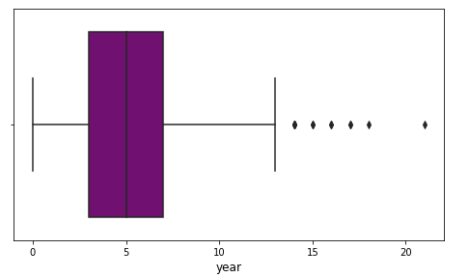
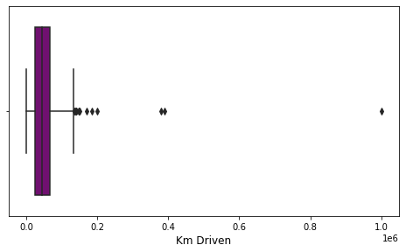
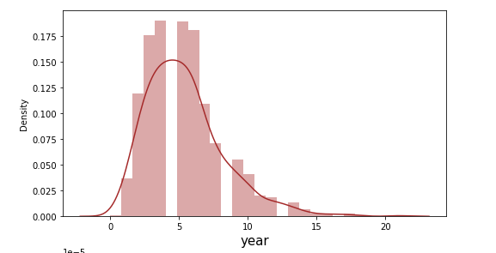
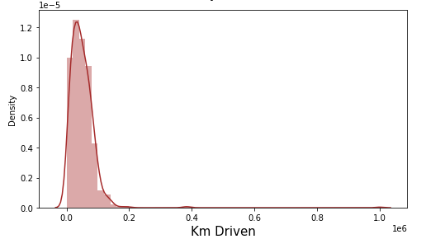
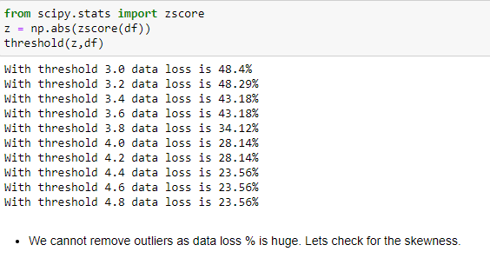

Outlier’s/Skewness:
Outlier’s not removed by using Z-SCORE as data
loss% was higher.
Skewness transformed by using Power transformation

Slide 7
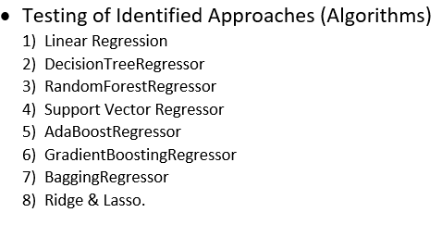
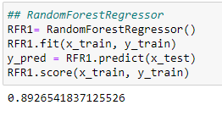

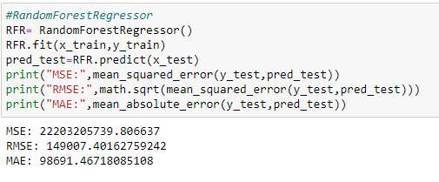
Model/s Development and Evaluation :
I have performed multiple algorithms to get the best model, and found out Random Forest Regressor is the best fit model out of all the other algorithms based on Cross validation, R2 Score, MSE, RMSE, MAE as shown in this slide.

Slide 8
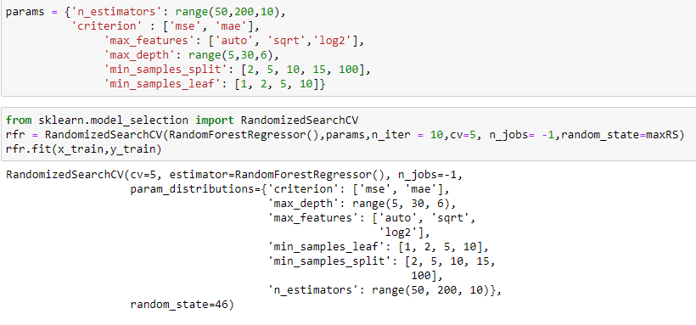

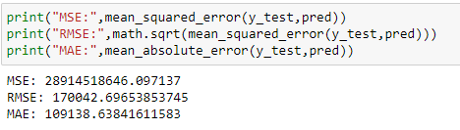
Hyper Parameter tuning
After using hyper parameter tuning, we observe accuracy could not increase. So I have kept the original accuracy of Random Forest Regressor, which gives 89% score with less MSE, RMSE & MAE error out of other models.

Slide 9
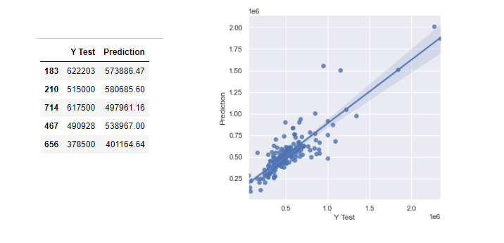
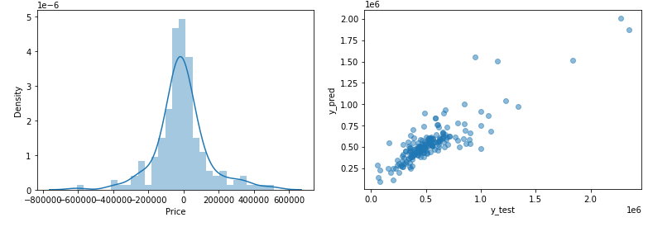
Conclusion
After performing the model building, I have got the highest score for RandomForestRegressor with 89% R2 score having less MSE, RMSE & MAE error as compare to other models but it could be due to overfitting, so I have checked for the cross validation scores & found 46% score, which gives very less difference between R2 score & CV score. Hence, based on Cross Validation Score, R2 score having less MSE, RMSE & MAE error, I have got the best fit model is RandomForestRegressor.
Also, the prediction is showing a similar relationship with the actual price from the train data set, which means the model predicted correctly & this could help the client to predict the price of the used cars & prospective to sell accordingly.

Slide 10
Thank you

